Slide 1
ENSE 496AB
Milestone 1
Health-Esteem
September 27th, 2018
Jennifer Herasymuik | Shawn Clake
Tristan Heisler | Quinn Bast
Wilson Nie | Chengyu Lou
Notes:
Shawn

Slide 2
Team Introductions
Team Members:
Jennifer Herasymuik
Shawn Clake
Tristan Heisler
Quinn Bast
Wilson Nie
Chengyu Lou
Team Name:
Health-Esteem
Assigned Project:
Braintrust
Notes:
Shawn

Slide 3
Review and Analysis
Readability of Braintrust’s Github
Like: The readme is informative
Like: Discussions document is well written
Dislike: Folder structure could be better
Dislike: Some ambiguity in feature descriptions
Notes:
Wilson

Slide 4
Review and Analysis (cont.)
Features
Like: Gamification
Like: Page Designs
Dislike: Graphical Statistics
Dislike: Too many navigation tabs
Dislike: PDCA -> PDEA
Notes:
Wilson

Slide 5
Revisioning
Changes Made
Changed wording of feature FR1-2
Reworded feature to focus on editing drafts
Removed features FR 4-1 & FR 4-1.1 (graphical representation of statistics)
Redundant - already mentioned in another feature
Planning to change tabular design
Feature Discussion
Notes:
Jenn

Slide 6
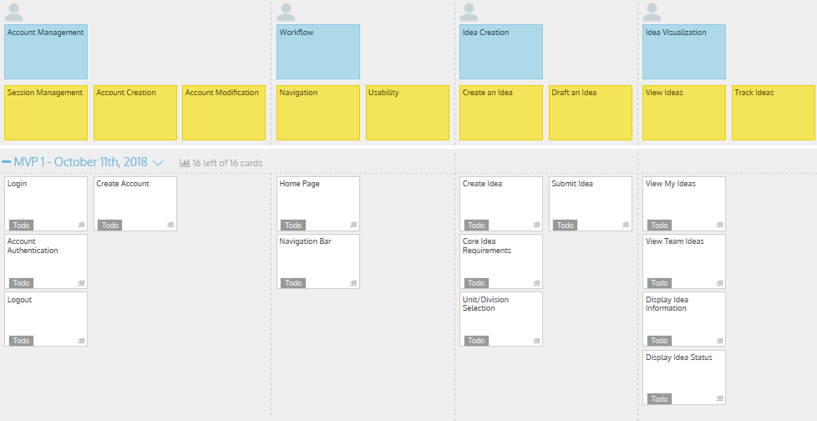
User Story Map -Release 1
Notes:
Tristan

Slide 7
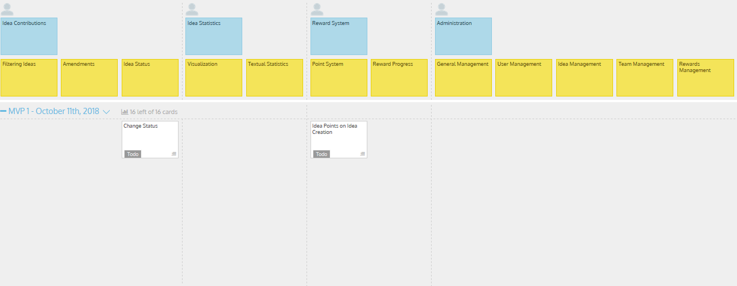
User Story Map - Release 1 (cont.)
Notes:
Tristan

Slide 8
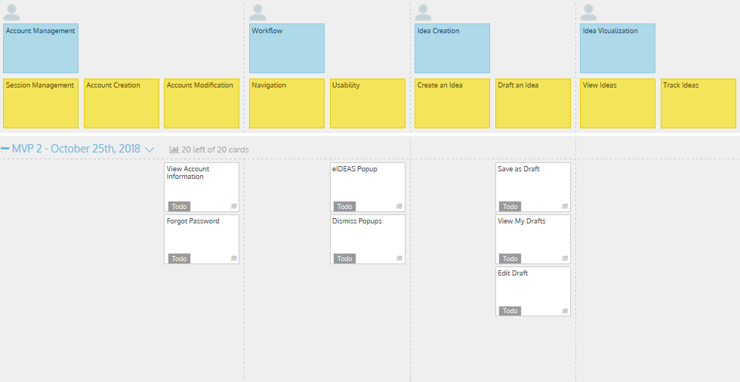
User Story Map -Release 2
Notes:
Quinn

Slide 9
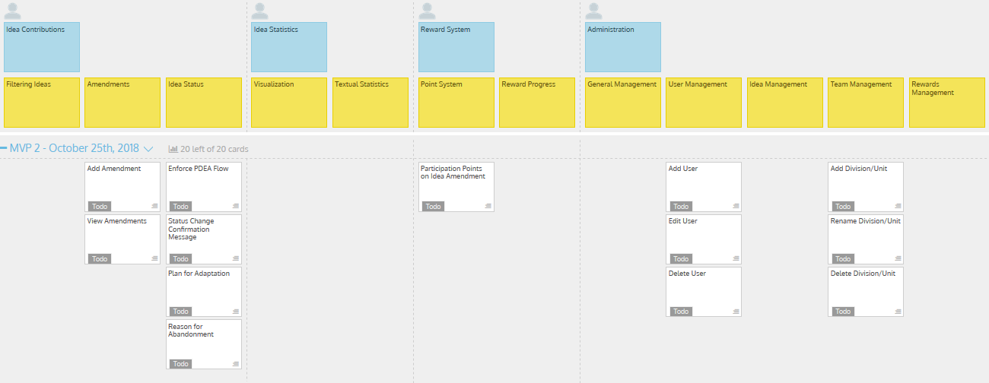
User Story Map - Release 2 (cont.)
Notes:
Quinn

Slide 10
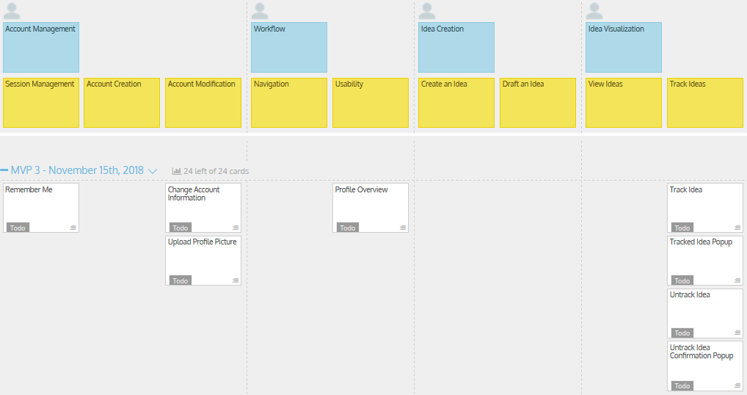
User Story Map -Release 3
Notes:
Jenn

Slide 11
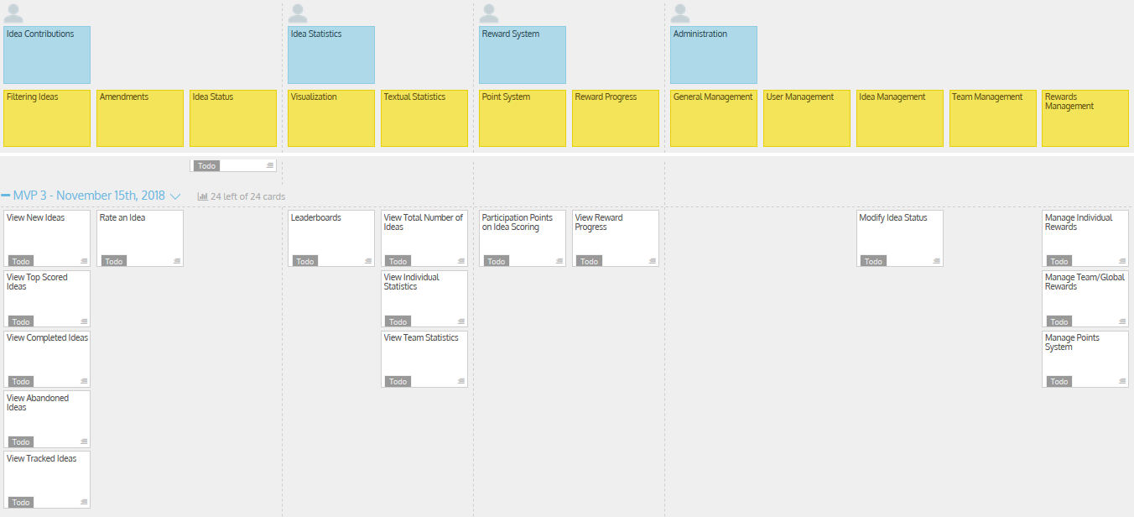
User Story Map - Release 3 (cont.)
Notes:
Jenn

Slide 12
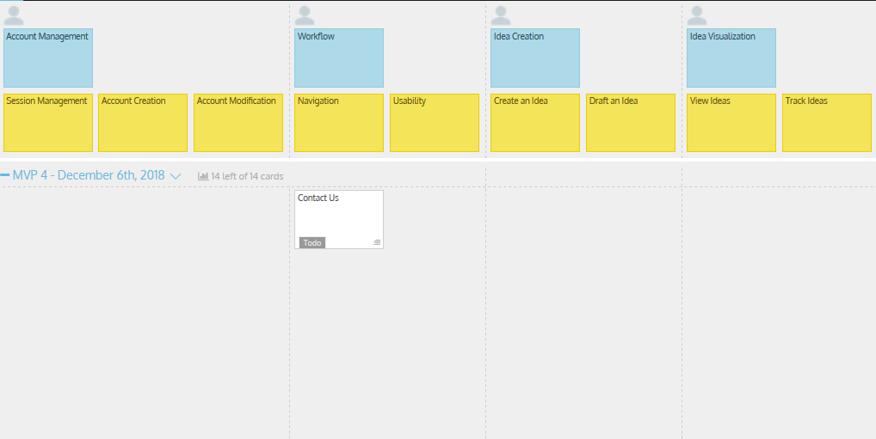
User Story Map -Release 4
Notes:
Oscar

Slide 13
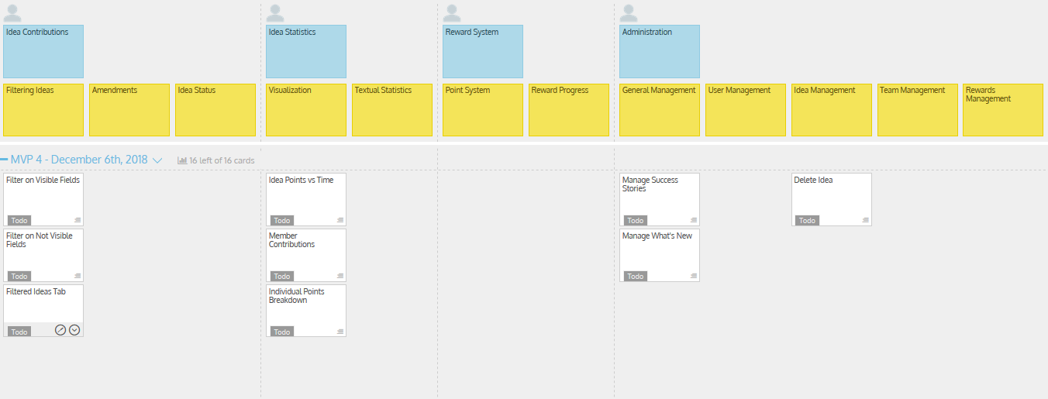
User Story Map - Release 4 (cont.)
Notes:
Oscar

Slide 14
User Story Map - Release Themes
Release 1 - October 11th, 2018
Features: Idea creation, submission, viewing, and progression. Account lifecycle,
session management, home page.
Purpose: To create an application that can achieve all core functional requirements as
discussed with Janice.
Release 2 - October 25th, 2018
Features: Drafts, amendments, idea status flow enforcement and administration of
users, units and divisions.
Purpose: To provide more flexibility for the user and promote further levels of
collaboration between team members using the software.
Notes:
Tristan

Slide 15
User Story Map - Release Themes (cont.)
Release 3 - November 15th, 2018
Features: Idea tracking, categories and rating. Leaderboards, textual statistics and
rewards for collaboration.
Purpose: To incorporate further quality of life improvements for interacting with ideas
and to implement positive reinforcement for utilizing the application.
Release 4 - December 6th, 2018
Features: Idea filtering, graphs, contact us, success stories and new information.
Purpose: To permit the filtering of ideas, visual representation of data and provisioning
of organizational information. This release will implement the changes that arise throughout the development process.
Notes:
Tristan

Slide 16
Areas of Envisioned Success
User Registration and Login
Users did not find this process confusing and most believed no functionality was missing.
Presentation of Information
The average responder believed that the right amount of information was being displayed for each idea.
Distinguishable Team Ideas
Users found that ideas are easy to pick apart and that the information provided is adequate to understand each idea.
Notes:
Quinn

Slide 17
Miscellaneous
Anonymity
Idea: Increase participation by reducing attachment
However: eHealth encourages human interaction by having discussion about ideas rather than isolation
Active Directory Authentication
Idea: Superior to username and password authentication
However: Difficult to implement and test outside of eHealth
Notes:
Wilson

Slide 18
Group Reflection
How do you feel about this milestone? What do you like about it? What did you dislike?
Like: Having the ability to review and critique the work done so far.
Dislike: Inheriting a design left little room for creative freedom.
Dislike: Confined to a specific language and framework which we may or may not know.
What did you learn about yourself as you collaborated and worked through this milestone?
We became familiar with the strengths of each other with regards to technology and industry experience.
Notes:
Shawn

Slide 19
Group Reflection (cont.)
How will you use what you have learned going forward?
We aim to divide work intelligently based on our strengths and preferences.
What “stuff & things” related to this milestone would you want help with?
We believe there would be value in having time to become more familiar with the technologies.
Notes:
Shawn

Slide 20
Questions?
Notes:
Shawn

